Slide 1
BASICS OF PONDFISH HEALTH Dr Erik Johnson DRJOHNSON.COM ALL IS THERE
It’s a drinking-game. Get out your hunch-punch.
You drink every time I relate HEALTH to the WATER QUALITY
You’ll be SMASHED by the end.

Slide 2
Most cases start and end water quality
Ammonia
Nitrite
Nitrate
pH
Alkalinity

Slide 3
SHORTCUT Get The 6-in-One kit and an Ammonia kit Test water absolutely first

Slide 4
COMMENTS ON PH, AMMONIA, NITRITE, NITRATE and ALKALINITY

Slide 5
AMMONIA is an uncommon problem in Eco Ponds BECAUSE BIOFILM – FIX WITH BIOSEEDING TRICKLE SYSTEM `Avoid shocks `IT GETS DONE (WC’s DON’T)

Slide 6
Nitrite RARE PROBLEM FOR NEW PONDS FIX: BIOSEEDING FIX TRICKLE SYSTEMS SALTING (Temporary) METHYLENE BLUE

Slide 7
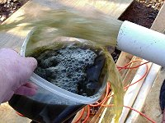
BIOSEEDING DONOR and RECIPIENT SYSTEMS SUPPORT PH SPONGE FILTER WORKS INSTANTLY (24HRS)

Slide 8
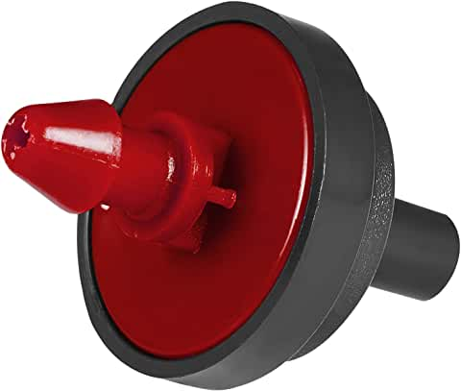
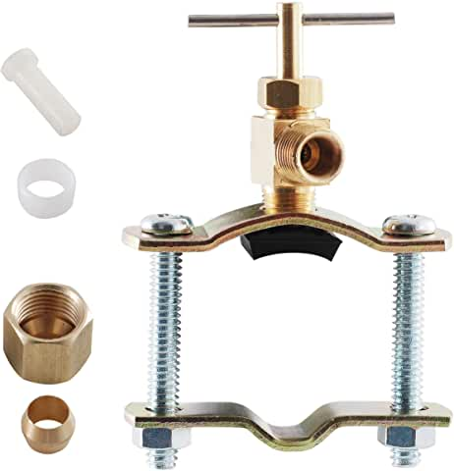
NITRATES IMMUNESUPPRESSIVE OVER 180 FIX: TRICKLE SYSTEM – WHY RAINBIRD? CHLORINE? PRESS-REG IMPORTANT FOR EMITTERS TO WORK

Slide 9
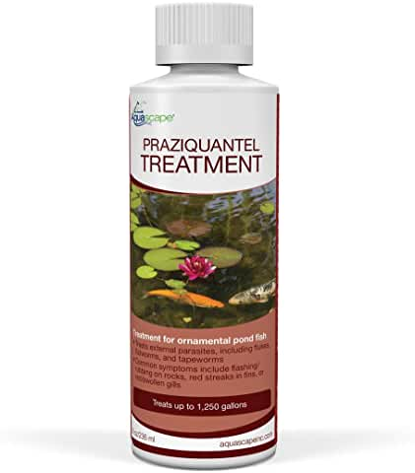
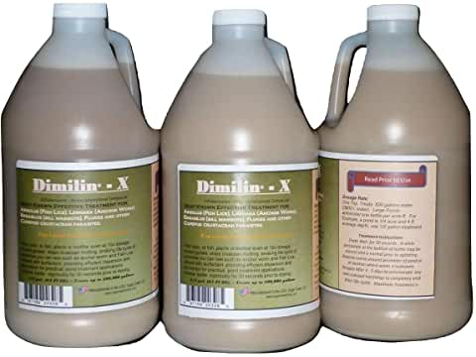
WHAT IF IT’S NOT WATER? SHOTGUNS THEN BUT BSDT IS SUPERBROAD - NOT IN 80+ H20

Slide 10
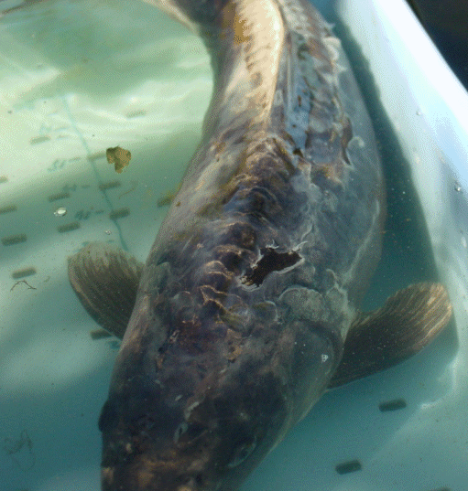
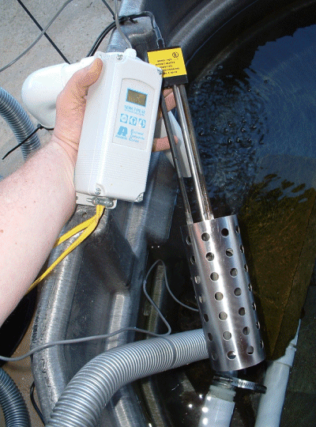
KHV? WHEN THEY’RE DYING HARD NOTE TEMPERATURES 70-80 ARE KEY WHY NOT TEST? (RESULTS TIME/REPORTABLE)

Slide 11
HEATING 1 DEG PER HOUR HIGH AERATION SMALLER FACILITY BIOSEED KEEP COVERED HARD TO REPLACE FISH IN POND 83 DF 2-3 days SAVED FISH ‘INFECTIOUS’ (NEVER HAPPENED)

Slide 12
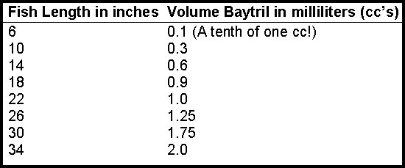
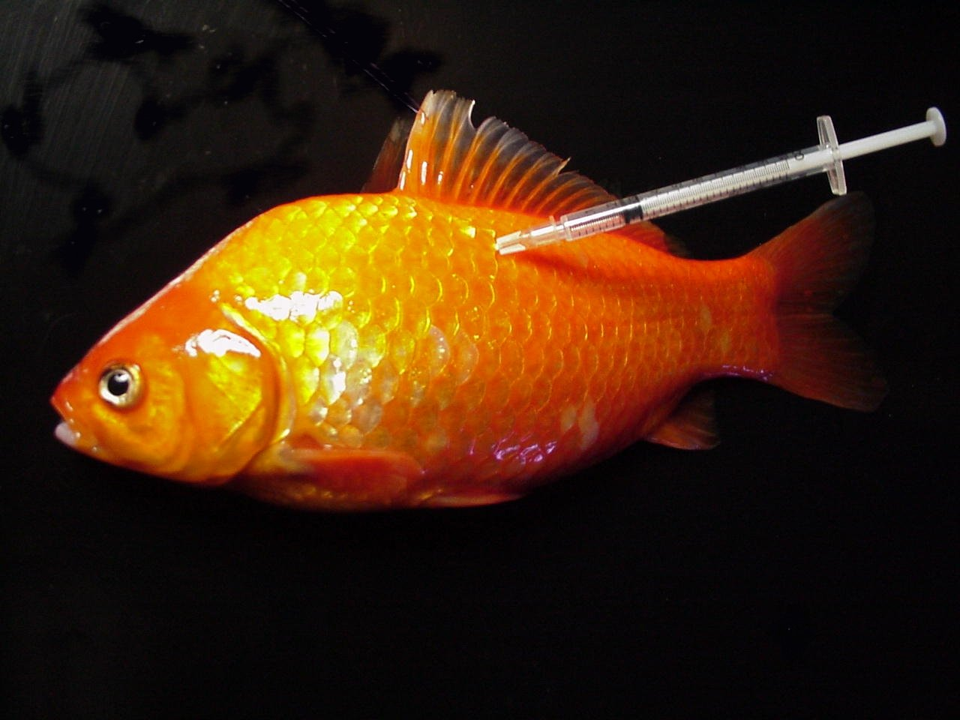
BACTERIAL / ROTTING

Slide 13
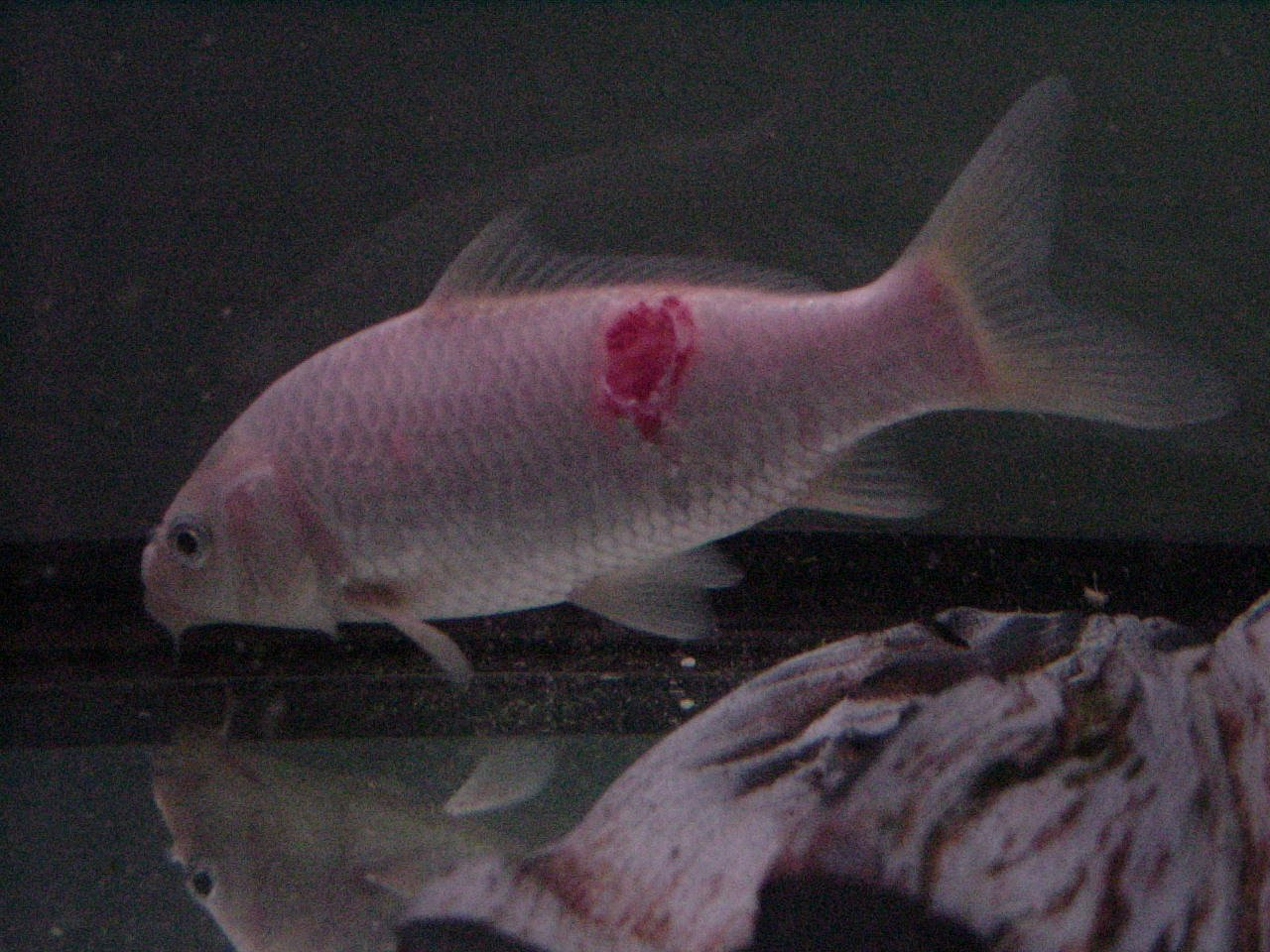
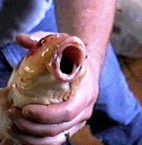
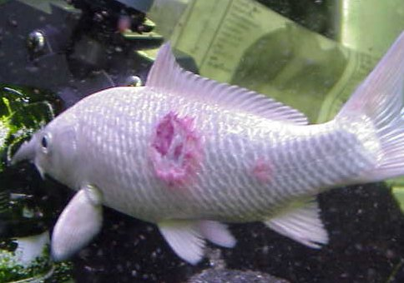
TAIL MOUTH GILL BODY

Slide 14
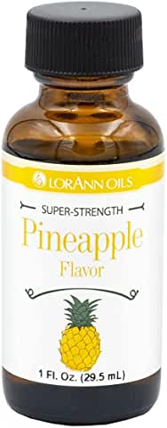
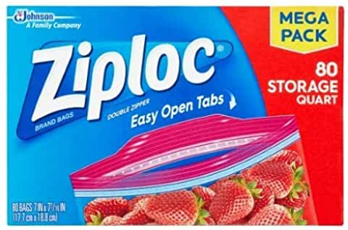
MEDICATED FEED - AQUAFLOR practically impossible to get https://drjohnson.com/medfood/mobile/index.html

Slide 15
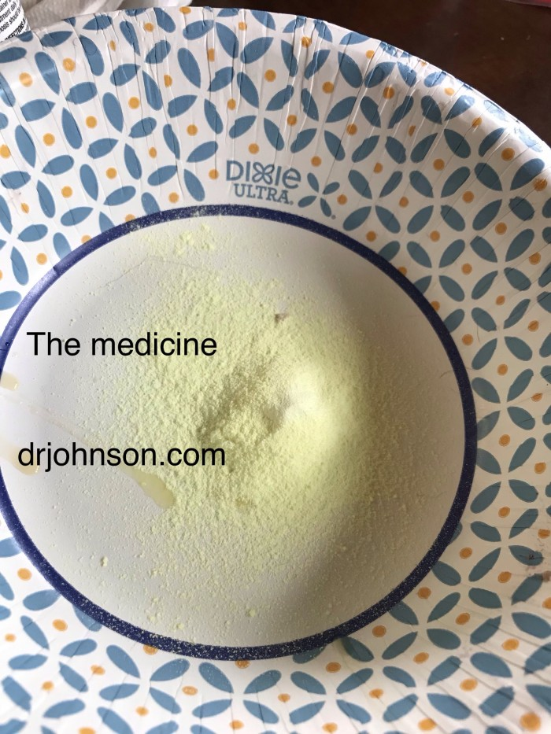
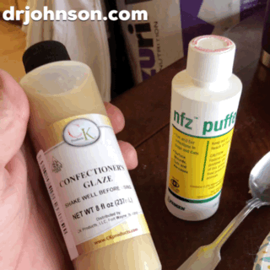
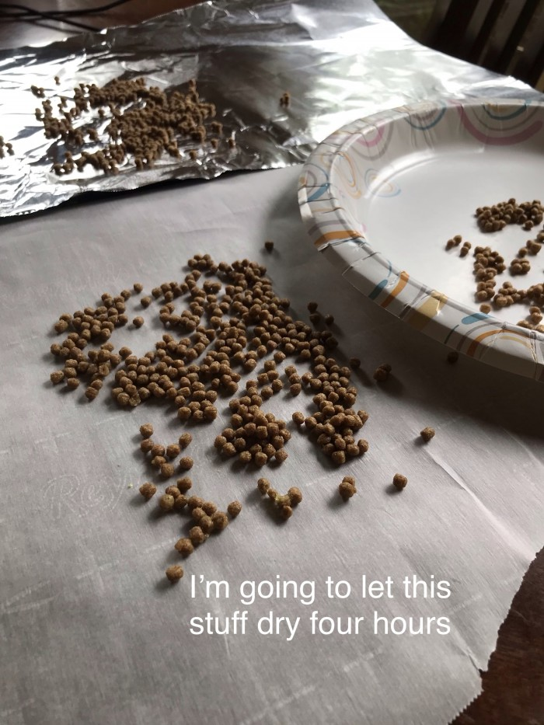
MIX IT UP IN ZIPLOC SPREAD ON WAX PAPER LET DRY DOSING AT FISHTREATMENTS.COM

